Slide 1
INPUTS
LEF (PHYSICAL LIBRARY)
LEF (LIBRARY EXCHANGE FORMAT)
Presented by
M Kullayappa

Slide 2
.LEF :
LEF Contains the physical information of a cell.
The lef cell gives the Vendors.
The LEF file is the abstract view of cells.
It only gives the idea about PR boundary, pin position and metal layers information of a cell.
To get the complete information about the cell, DEF(Design exchange format) file is required.
In this lef 3 sections are defined i.e. technology, site, macros.

Slide 3
In the technology part layers, design rule, via definitions and metal capacitance are defined.
in the site , site extension is defined .
In the macros the information of about cell description, dimension, layout of pins and blockages and capacitance are defined.
In this lef technology for every layer and the via statements are different .
So for the layer and via , the type of the layer width/pitch and spacing, direction, resistance and antenna factor are defined.

Slide 4
The .lef cell is classified into two types
CELL lef and TECH lef.
CELL LEF:
CELL lef Contains the physical info of macros and std cells.
It contains the direction of input and output pins, signal, ports,
antenna area , size of the cell, symmetry of the cell, pin location,
pin name , site unit , origin , class core.

Slide 5
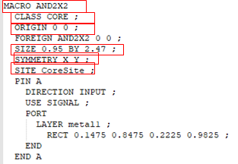
Example of cell lef

Slide 6
TECHNOLOGY LEF:
Tech lef Contains the physical info of metal layers , vias information.
It contains the layer P0 in
type masterslice
Layer C0 in
type cut and spacing
Layer M1
type routing , directional , pitch, width, area, max width,
min width , min density , max density , density check window ,ect..

Slide 7
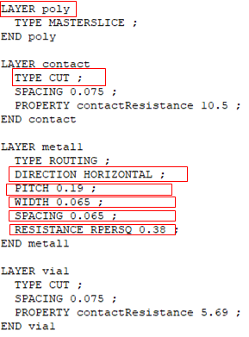
Example of tech lef

Slide 8
Physical libraries format is in .lef
Physical information of std cells, macros, pads.
Pin information.
Minimum width of resolution.
Height of the placement rows.
Preferred routing directions.
Pitch of the routing tracts.
Antenna rules.
Routing blockage.

Slide 9
Antenna ratio= metal area/gate area.
In physical information height, area, width are present and also it
constraints two vias.
Cell View : in this layer all info is present and it is used at the time of
tape out.
Fram View : in fram view is abstract view and it is used at the placement and routing.

Slide 10
THANK YOU

